Slide 1

Hi!
你好
more amusement. more acquisition. mora.

Slide 2




Meet the Team!
Bryant Perkins
Candy Tang
Lulu Sullivan
Tommy DeBenedetti
Senior
Senior
Junior
Junior
Computer Science
Urban Studies
Computer Science
Undeclared

Slide 3
The Problem & Our Solution
The value proposition of Mora is to save the language learner of all levels who loves watching TV and movies from the tedious, decontextualized language learning techniques of old.
Mora is a companion for streaming which interrupts your watching with live language lessons and links to an app which summarizes your stats, curates review material for your favorite shows, and connects you to interest-based communities of language learners to bond and/or compete live with.

Slide 4
Values in Design
Tensions
Educational
Fun
Inclusive
Users are able to learn relevant and useful language skills from Mora.
Users think Mora is fun and want to use it in their free time.
Users of all levels and backgrounds feel the Mora experience meets their needs.
“Fun” for one person may be uncomfortable for others (ex. competition)
Balancing fun of watching TV with real learning experience

Slide 5
Values in Design
Value: | Design Features:
Educational | Contextual lessons based on user’s TV/movie interests and related quizzes Chat for conversational learning with other users Settings page to adjust complexity/difficulty to personal level of learning
Fun | Games and competition TV — your own show of choice allows users to define own fun Chat with other users to engage in your interests
Inclusive | Language lessons tailored to users’ ability, interests, needs All competition, conversation = opt-in Multimodal (audio, visual, haptic) interface for lesson notification Media-based study sets available to those without streaming access Redundancy of meaning of red/green features

Slide 6
TASKS
* no changes from Low-Fi.
Salut!

Slide 7
Simple Task
Engage with entertainment of choice and learn from the interactive lesson.
Notes:
Changed the homescreem — should we change that in the joard and re-screen shot
Switched to a nav bar interface
Subtitles for buttons
Incorporate grammar lessons in addition to vocabulary lessons
Play button unclear → make it an arrow

Slide 8
Moderate Task
Review previously seen material through in-app practice.
Notes:
Have the complexity be tailorable to users’ ability — many were bored and unchallenged

Slide 9
Complex Task
Organize a synchronous, optionally competitive watch party for your media-language community.
Notes:
Leaning into the competitive

Slide 10
USABILITY
Goals & Measurements
Salut!

Slide 11
1: FUN
2: EAGERNESS
3: INTUITIVE
vs
the average language learning experience
(measured 1-5)
to use the app
(measured 1-5)
to navigate the app
(measured by # misclicks)

Slide 12
Progress towards… FUN
All channels are opt in (fun for some is other people, and for some it is not)
Mora recommends users shows they may be interested in (encourages TV watching, not just learning)
Progress bars add to gamification of learning experience

Slide 13
Progress towards… EAGERNESS
Customizable language learning experience (a common complaint from low-fi)
Difficulty levels
Frequency of lessons
Interruptions vs Suggestions (more user agency)
Word of the day brings users a daily feature

Slide 14
Progress towards… INTUITIVE
New pair to screen button
Tab navigation system (options accessible throughout app)
Arrow buttons more descriptive

Slide 15
MAJOR CHANGES
Salut!

Slide 16
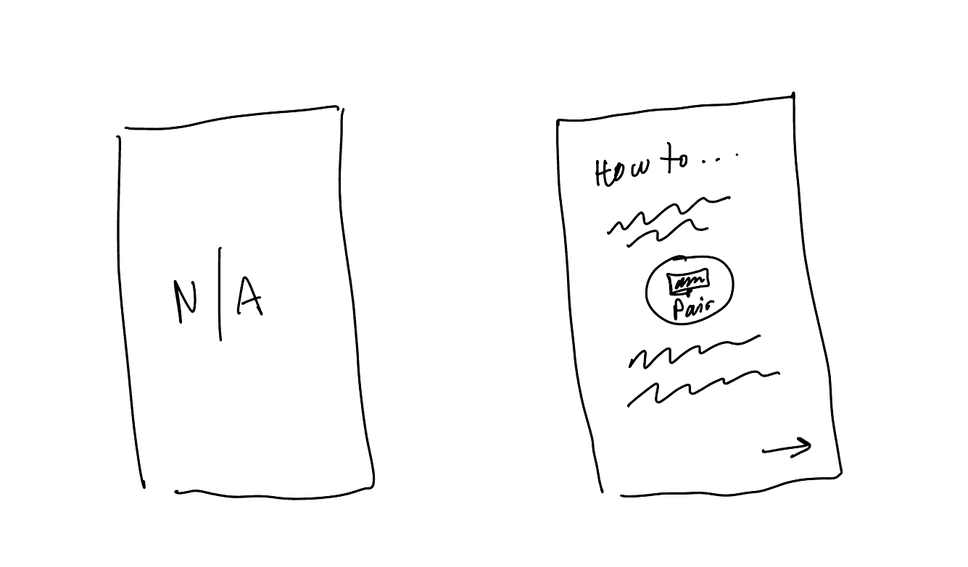
Onboarding
Make user aware of how Mora works: we will be interrupting your streaming with lessons
Give initial explanation of setup and customization
Goal progress:
Intuitive: users know initial premise of app
Eagerness: users are immediately aware that they can customize language learning settings

Slide 17
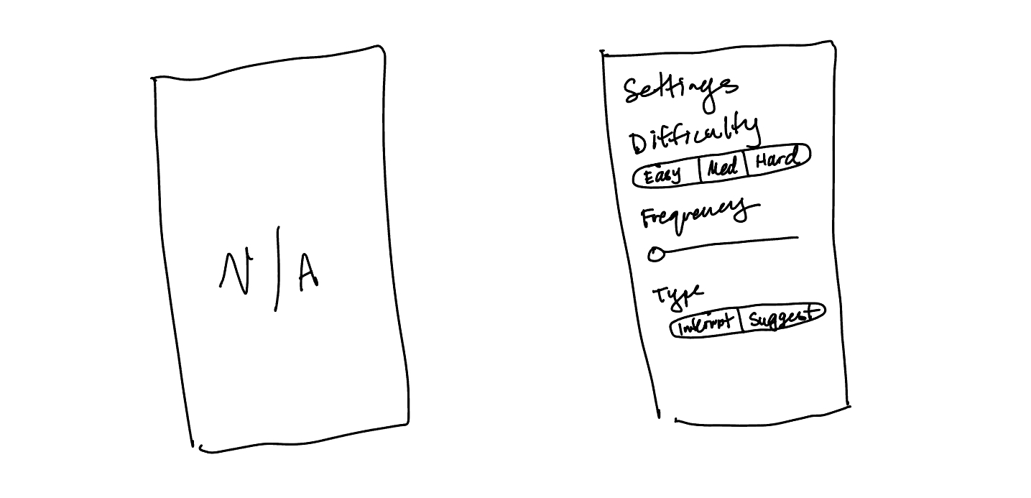
Customization
Customization settings for every time you use Mora while watching
Difficulty: how hard is your vocab?
Frequency: how often are lessons?
New feature: suggestions instead of interruptions allow user to reject lessons if they want to keep watching
Goal progress:
Eagerness: users can customize language learning settings
Fun: users have agency in how much learning they do, mitigating potential annoyances at unavoidable lessons

Slide 18
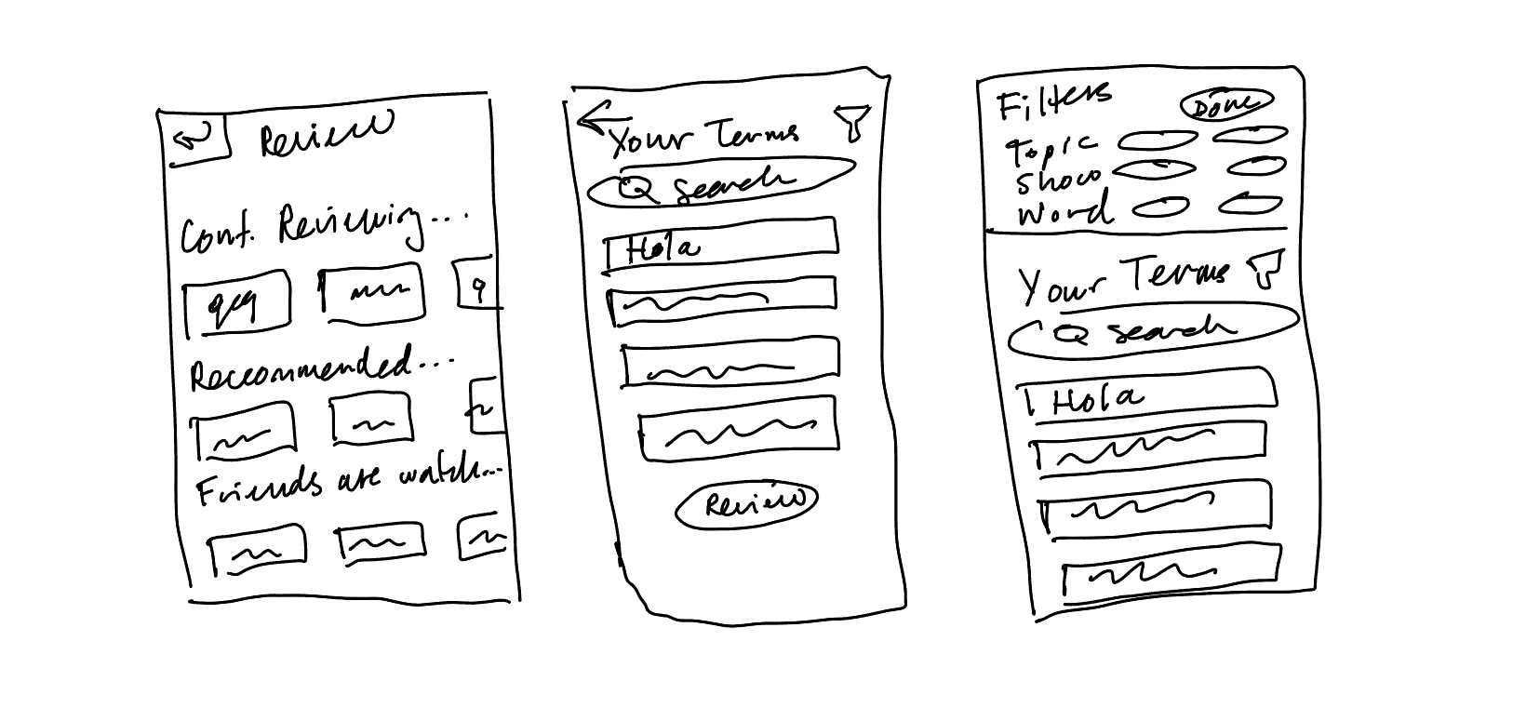
Review by Term
Allow users to review vocab by term, theme, or show (instead of only show)
Vocab still connected to shows it came from to contextualize it
Goal progress:
Intuitive: users can study vocab based on how difficult it is for them, a general theme, or the context of the show
Intuitive: users have more agency in filters, making the user experience more natural

Slide 19
MED-FI TASK FLOWS
Salut!

Slide 20
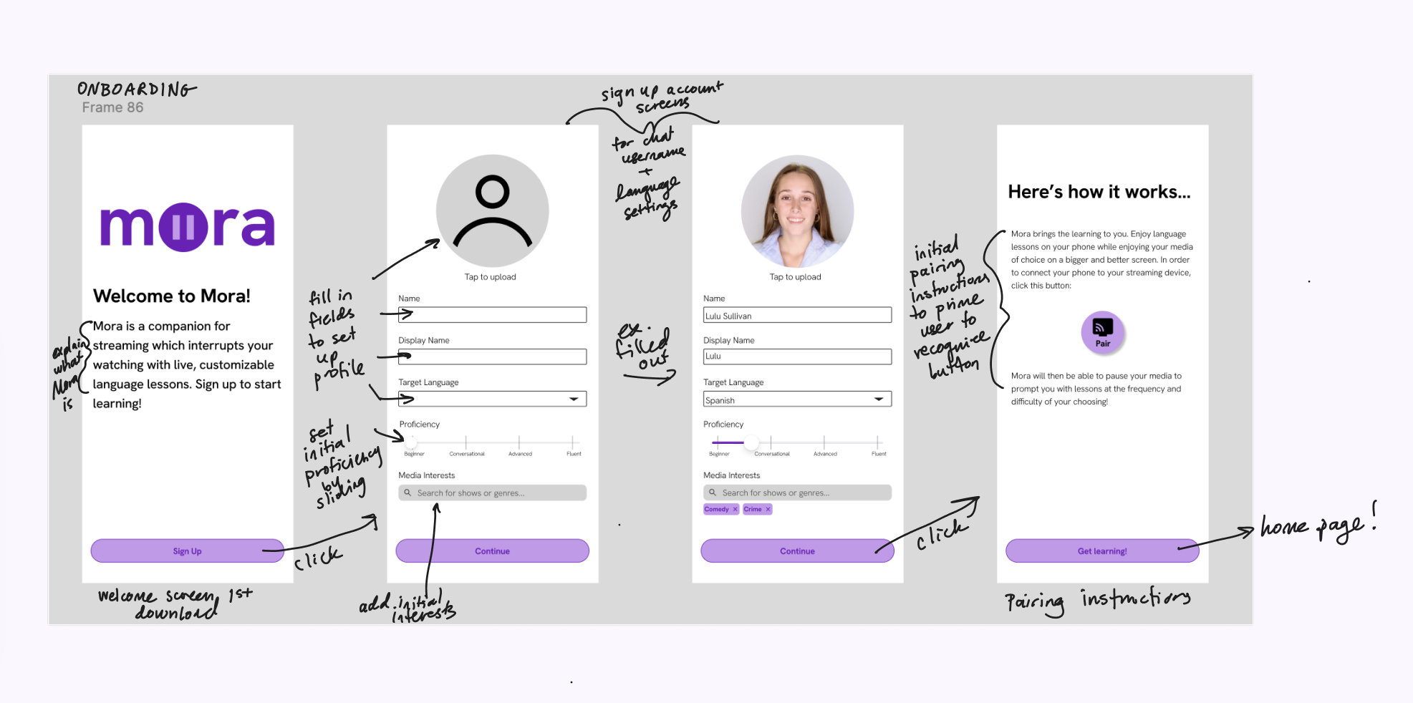
Onboarding

Slide 21
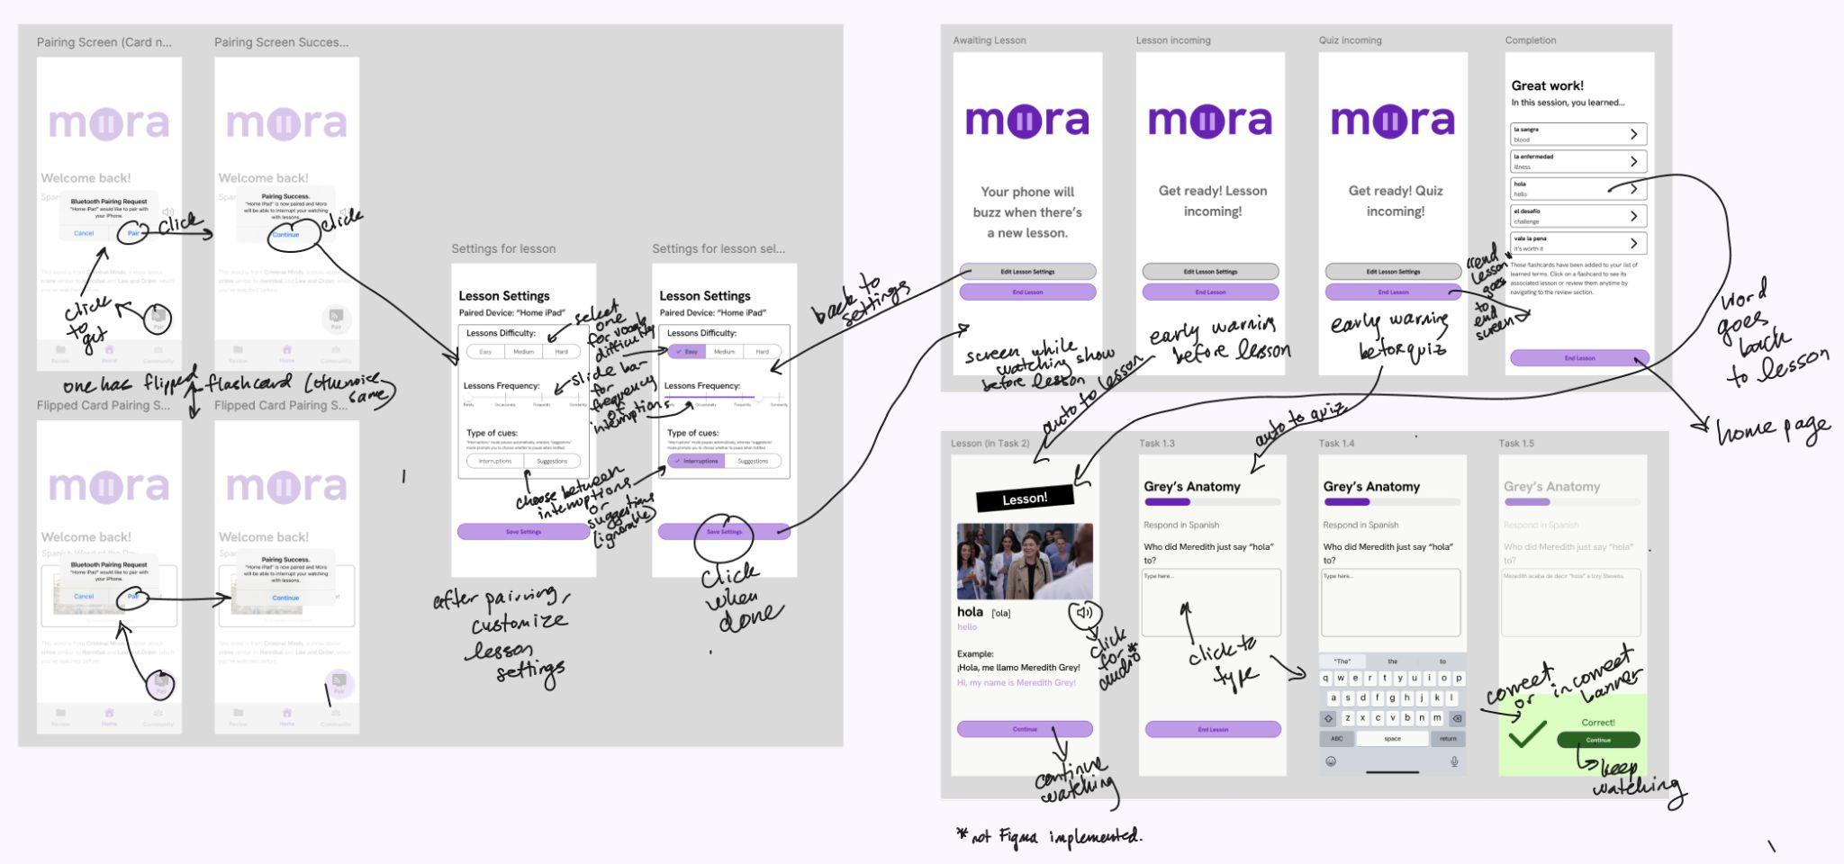
Engage and Learn with Entertainment

Slide 22
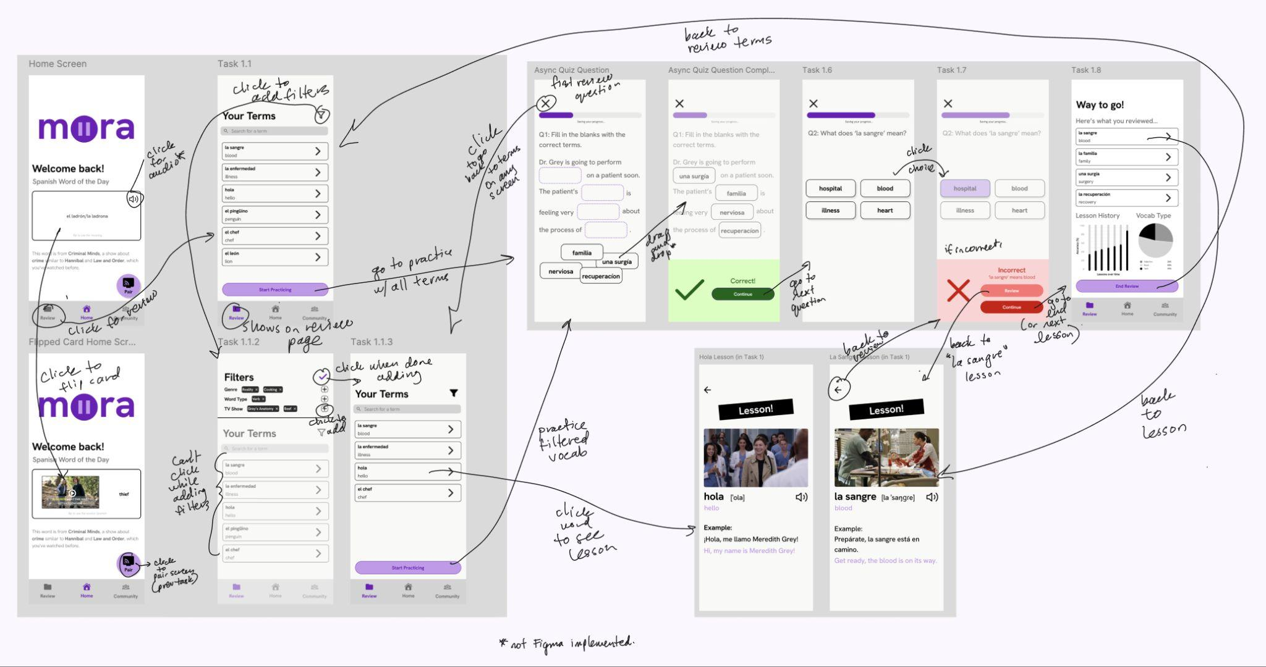
Review Vocab

Slide 23
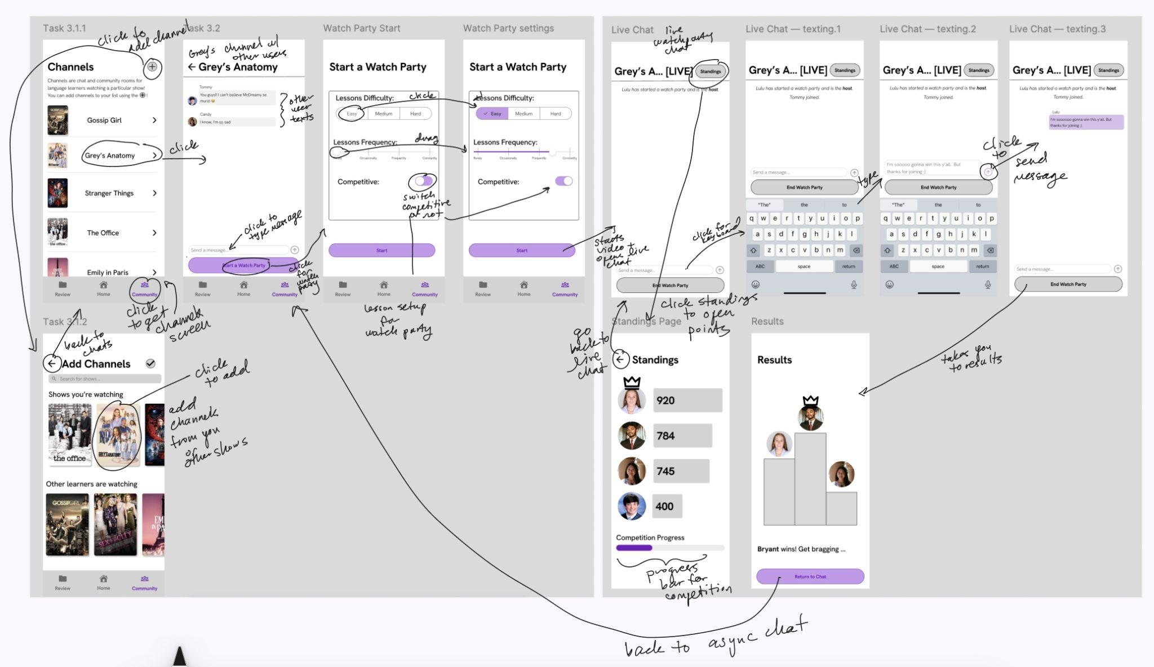

Start Watchparty

Slide 24
PROTOTYPE
Salut!

Slide 25
Tools
Figma: We chose to use Figma for our Med-Fi Prototype because it is an industry standard for designing phone app screens in relatively high fidelity without implementing any backend.
Pros:
Lots of capabilities including transitions, phone frames etc that replicate real phone app
Tools like components and grids make design easier
Cons:
Steep learning curve to effectively use
Using built-in assets may curb creativity

Slide 26
Limitations
No real conversational element: we couldn’t create an interface where users could interact with other users
No live TV component: unlike the low-fi prototype, we couldn’t implement a real live TV component without a “Computer” pressing play/pause or creating a bluetooth backend
No real customization: while there is now a screen for customization, we could not implement personalized language learning levels (or even real choice in TV show) without an AI lesson creator
No audio/haptic feedback: multimodal quiz notifications don’t have audio or buzzing features.

Slide 27
Hard-coded/Wizard of Oz
Only one option for language you learn, difficulty, frequency of lessons, etc hard-coded in
All profile information is hard-coded
Pairing of devices is not real
All chosen pause moments and words are hard-coded
Typing answers/drag and drop answers are hard-coded
Typing chats is hard-coded
Choosing show is hard-coded
Standings and stats are not real and are hard-coded
Must interrupt instead of suggest because screen is not actually paired to phone

Slide 28
LINK TO MED-FI:
Mora Prototype
Ciao!
Hola

Slide 29
Appendix
Salut!

Slide 30
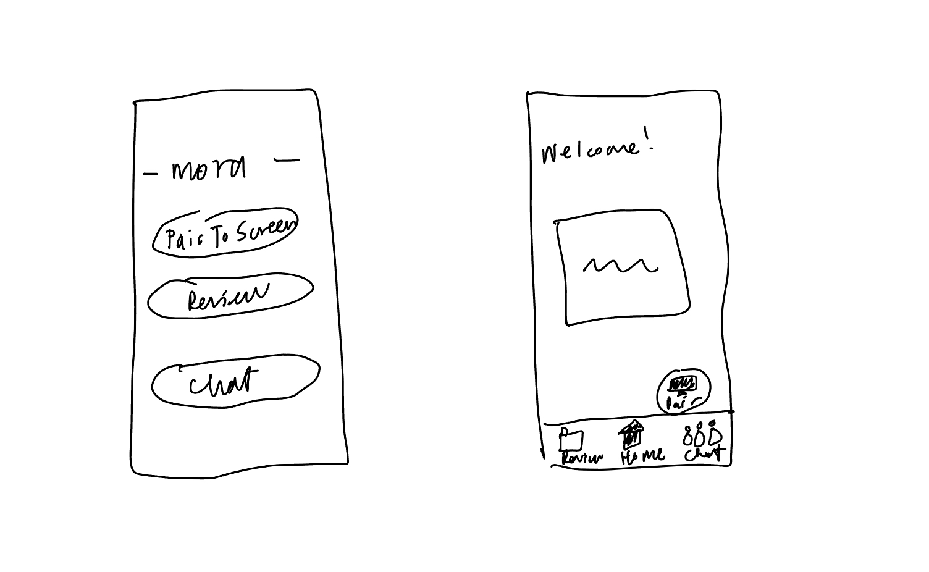
Major changes (cont.)
4. Pair to Screen
Floating pair to screen icon always accessible to start watching whenever
“Pair” and computer image to double add recognition
Onboarding screen for initial explanation
Goal progress:
Intuitive: two forms of recognition in design
Intuitive: initially defining in onboarding to make recall easier when looking at two forms of recognition

